Slide 1
New Features at VS Ultimate 2013
By Rob Feng

Slide 2
Purpose
Quickly get the information you need, in context (CodeLens)
Use tools to understand the relationships in existing code (CodeMap)
Visualize the structure of an application with UML diagrams (UML)
Describe and enforce architectural dependencies (Layer Diagrams)
Use IntelliTrace for historical debugging, even in production (IntelliTrace)
Notes:
What's New in Developer Quality and Diagnostic Tools in Visual Studio 2013 http://msdn.microsoft.com/en-us/library/hh704261.aspx
What’s New for the Debugger in Visual Studio 2013 http://msdn.microsoft.com/en-us/library/01xdt7cs.aspx

Slide 3
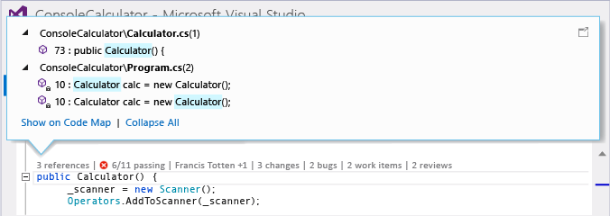
CodeLens
Find out more about your code without leaving the editor when you use CodeLens. You can find code references, changes to your code, linked bugs, work items, code reviews, and unit tests – all in the same context as your code.
All reference of the code
Tested By
Test list
Test Ouput
Test Status
Git Authors and Changes
The last person
Total changes
View Changest
Keboard Access
Alt + Num swtich CodLens section
Alt + Left/Right arrow to change section
Support Option control Fonts, Colors and Enable.
Notes:
CodeLens aka Code Information Indicators (Reference, Test and Change) http://blogs.msdn.com/b/zainnab/archive/2013/07/09/visual-studio-2013-preview-codelens-aka-code-information-indicators.aspx
Find code changes and other history with CodeLens http://msdn.microsoft.com/en-us/library/dn269218.aspx

Slide 4
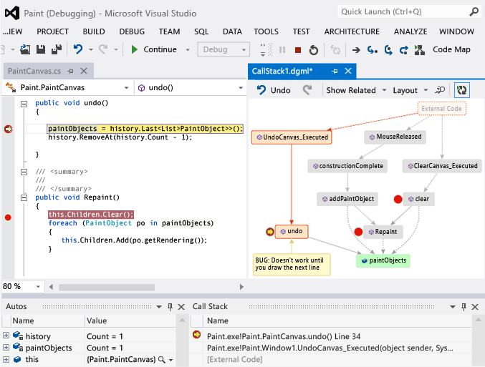
CodeMap
Find out more about your code without leaving the editor when you use CodeLens. You can find code references, changes to your code, linked bugs, work items, code reviews, and unit tests – all in the same context as your code.
Debug
Map call stack
Update with next call stack
Add comments
Add related code
Notes:
Map methods on the call stack while debugging in Visual Studio http://msdn.microsoft.com/en-us/library/dn194476.aspx

Slide 5
UML
Modeling diagrams help you understand, clarify, and communicate ideas about your code and the user requirements that your software system must support.
Class Diagram
Sequence Diagram
Generate Sequence Diagram from source code
Use Case Diagram
Activity Diagram
Component Diagram
Layer Diagram
Directed Graph Document
Dependency Graph / CodeMap in Solution Explorer
Notes:
Developing Models for Software Design http://msdn.microsoft.com/en-us/library/vstudio/dd409436.aspx
Properties of Associations in UML Class Diagrams http://msdn.microsoft.com/en-us/library/vstudio/dd323862.aspx

Slide 6
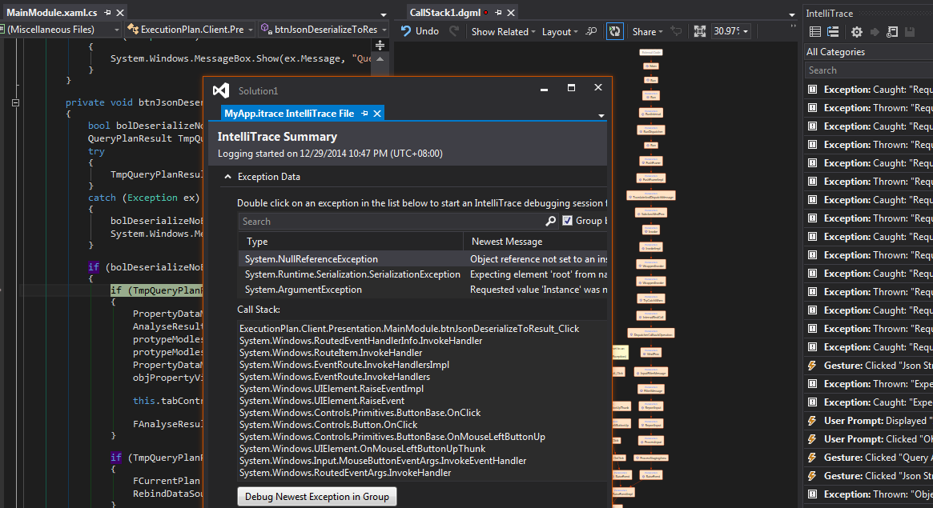
IntelliTrace
Spend less time debugging your app in Visual Studio Ultimate when you use IntelliTrace to record and trace your code's execution history. You can find bugs more easily without setting lots of breakpoints because IntelliTrace lets you:
Record specific events that happened in your app. You can examine related code, data that appears in the Locals window during debugger events, and function call information, if you choose to collect it.
Reduce restarting your app to recreate bugs or events.
Debug errors that are hard to reproduce or that happen in deployment.
Notes:
Debug Your App by Recording Code Execution with IntelliTrace http://msdn.microsoft.com/en-us/library/dd264915.aspx

Slide 7
Setup IntelliTrace:
1. Download
http://www.microsoft.com/en-us/download/details.aspx?id=44909
2. Create folder C:\IntelliTraceCollector
3. Save IntelliTraceCollector.exe to the collector directory, for example: C:\IntelliTraceCollector
4. Run IntelliTraceCollector.exe (Get the IntelliTraceCollection.cab)
5. Use Cmd Browse to the collector directory, for example: C:\IntelliTraceCollector
6. Use the expand command, including the period (.) at the end, to expand IntelliTraceCollection.cab:
expand /f:* IntelliTraceCollection.cab .
7. Create folder C:\IntelliTraceLogFiles
8. Cmd Run:
C:\IntelliTraceCollector\IntelliTraceSC.exe launch /cp:"C:\IntelliTraceCollector\collection_plan.ASP.NET.default.xml" /f:"C:\IntelliTraceLogFiles\MyApp.itrace" "C:\MyApp\MyApp.exe"

Slide 8
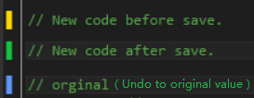
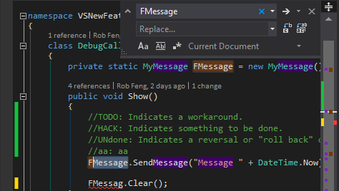
Other Features
Auto Run Test
Editor Feature
Color of the left margin, Color of the right margin
Navigate To (Ctrl + ,), Finds a symbol or file in the active solution
Using Regular Expressions in Find or Replace Text
Peek Definition / Peek Help
Task List
Scroll bar source overview
Examine return values of method calls
Verifying Code by Using UI Automation
Analyzing Application Quality

